Slide 1
Chapter 4- File Systems

Slide 2
Introduction to File Systems
File systems
From users point of view
Implementation point of view

Slide 3
Introduction…
File Naming
Files are an abstraction mechanism.
They provide a way to store information on the disk and read it back later.
This must be done in such a way as to shield the user from the details of how and where the information is stored, and how the disks actually work.
The exact rules for file naming vary somewhat from system to system

Slide 4
Introduction…
Extension | Meaning
file.bak | Backup file
file.c | C source program
file.gif | Compuserve Graphical Interchange Format image
file.hlp | Help file
file.html | World Wide Web HyperText Markup Language document
file.jpg | Still picture encoded with the JPEG standard

Slide 5
Introduction…
File Structure
Unstructured sequence of bytes
A file is a sequence of fixed length records
A file is a tree of records

Slide 6
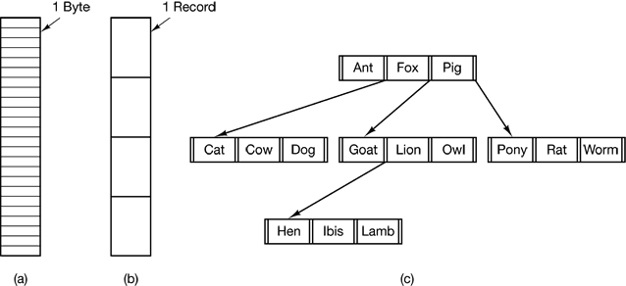
Introduction…

Slide 7
Introduction…
File Types
Regular files
Character special files
Block special files
File Access
Sequential
Random
File Attributes:
all operating systems associate auxiliary information with each file

Slide 8
Introduction…
File Operations
Create
Delete
Open
Close
Read
Write
Append
Seek
Get attributes
Set attributes
Rename

Slide 9

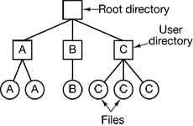
Introduction…
Directory
Single-Level Directory Systems
Two-level Directory Systems
To avoid conflicts caused by different users choosing the same file name for their own files, the next step up is giving each user a private directory

Slide 10
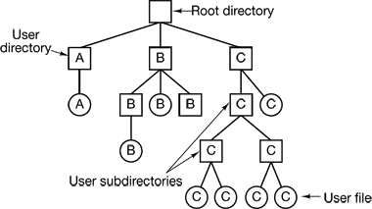
Introduction…
Hierarchical Directory Systems
Path Names
When the file system is organized as a directory tree, some way is needed for specifying file names.
Absolute path
Relative path
Eg. – Absolute path
Windows \usr\ast\mailbox
UNIX /usr/ast/mailbox

Slide 11
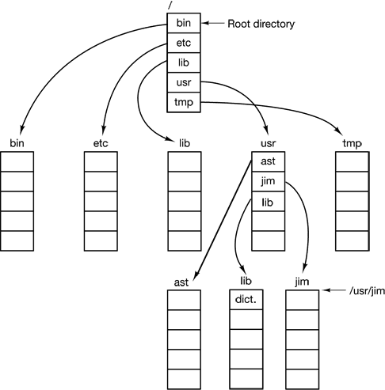
Introduction…
cp ../lib/dictionary .

Slide 12
Introduction…
Directory operations
Create
Delete
Opendir
Closedir
Readdir
Rename
Link
Unlink

Slide 13
File system implementation
From the user’s view of the file system to the implementor’s view
File System Layout
MBR (Master Boot Record) – used to boot the computer
The end of the MBR contains the partition table.
This table gives the starting and ending addresses of each partition.
One of the partitions in the table is marked as active
When the computer is booted, the BIOS reads in and executes the MBR.
The first thing the MBR program does is locate the active partition, read in its first block, called the boot block, and execute it

Slide 14
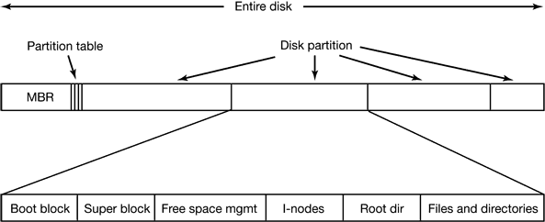
File system implementation…
The layout of a disk partition varies from file system to file system
superblock- contains all the key parameters about the file system and is read into memory when the computer is booted

Slide 15
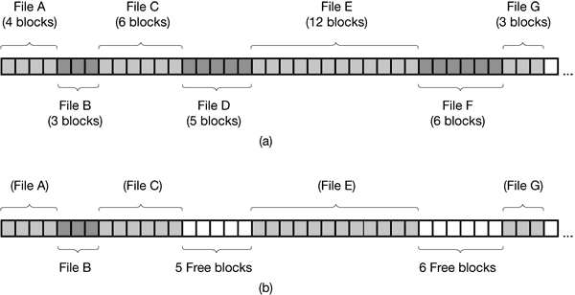
Implementing Files
Contiguous Allocation

Slide 16
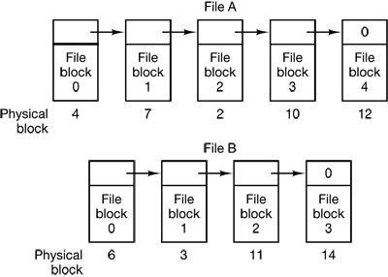
Implementing Files…
Application of Contiguous allocation:
CD-ROM
Linked List Allocation

Slide 17
Implementing Files -Linked List Allocation
linked list of disk blocks
The first word of each block is used as a pointer to the next one. The rest of the block is for data
Unlike contiguous allocation, every disk block can be used in this method
No space is lost to disk fragmentation (except for internal fragmentation in the last block).
The disk address of the first block
The rest can be found starting there.

Slide 18
Implementing Files -Linked List Allocation…
Disadvantages:
On the other hand, although reading a file sequentially is straightforward, random access is extremely slow.
To get to block n, the operating system has to start at the beginning and read the n – 1
Also, the amount of data storage in a block is no longer a power of two because the pointer takes up a few bytes.

Slide 19
Implementing Files -Linked List Allocation…
Storing a file as a linked list of disk blocks

Slide 20
Implementing Files -Linked List Allocation Using a Table in Memory
Both disadvantages of the linked list allocation can be eliminated by taking the pointer word from each disk block and putting it in a table in memory.

Slide 21
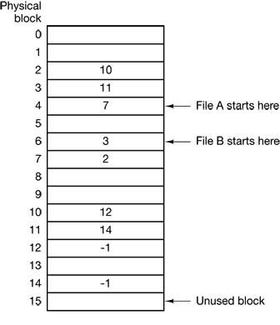
Implementing Files -Linked List Allocation Using a Table in Memory

Slide 22
Implementing Files -Linked List Allocation…
Using this organization,
the entire block is available for data.
Furthermore, random access is much easier.
Although the chain must still be followed to find a given offset within the file, the chain is entirely in memory, so it can be followed without making any disk references.
The primary disadvantage of this method is that the entire table must be in memory all the time to make it work.

Slide 23
I-node
Indexed node
keeping track of which blocks belong to which file.
which lists the attributes and disk addresses of the files blocks
Given the i-node, it is then possible to find all the blocks of the file.
The big advantage of this scheme over linked files using an in-memory table is that the i-node need only be in memory when the corresponding file is open.

Slide 24
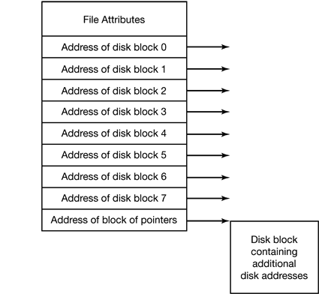
I-node…

Slide 25
Assignment
i-node
Directory Implementation- where are file attributes stored?

Slide 26
Directory Implementation
Before a file can be read, it must be opened. When a file is opened, the operating system uses the path name supplied by the user to locate the directory entry.
The directory entry provides the information needed to find the disk blocks.
Depending on the system, this information may be the disk address of the entire file (contiguous allocation), the number of the first block (both linked list schemes), or the number of the i-node.
In all cases, the main function of the directory system is to map the ASCII name of the file onto the information needed to locate the data.

Slide 27
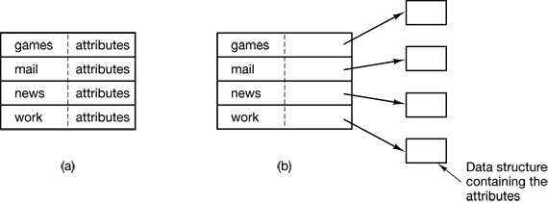
Directory Implementation…
a)- A simple directory containing fixed-size entries with the disk addresses and attributes in the directory entry.
b)- A directory in which each entry just refers to an i-node.

Slide 28
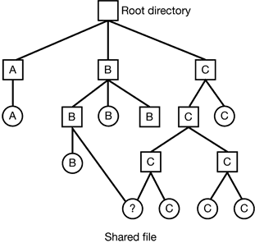
Shared Files
When several users are working together on a project, they often need to share files.
The connection between B’s directory and the shared file is called a link.
The file system itself is now a Directed Acyclic Graph, or DAG, rather than a tree.

Slide 29
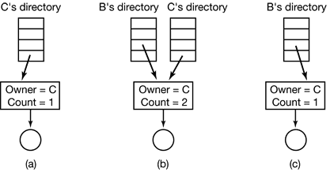
Shared Files…

Slide 30
Disk Space Management
Files are normally stored on disk, so management of disk space is a major concern to file system designers.
Strategies
storing an n byte file: n consecutive bytes of disk space are allocated,
file is split up into a number of (not necessarily) contiguous blocks.

Slide 31
Disk Space Management…
Block Size
Once it has been decided to store files in fixed-size blocks, the question arises of how big the block should be.
Having a large allocation unit
Disk space wastage
Having a small allocation unit
each file will consist of many blocks
Reading each block normally requires a seek and a rotational delay, so reading a file consisting of many small blocks will be slow.

Slide 32
Disk Space Management…
Example:
Consider a disk with 131,072 bytes per track, a rotation time of 8.33 msec, and an average seek time of 10 msec.
The time in milliseconds to read a block of k bytes is then the sum of the seek, rotational delay, and transfer times
10 + 4.165 + (k/131072) × 8.33

Slide 33
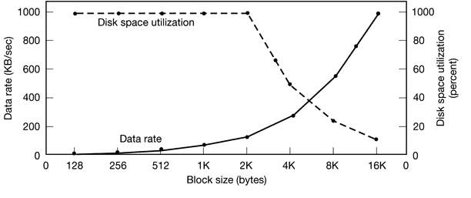
Disk Space Management…

Slide 34
Disk Space Management…
Assignment
How Windows and Linux Keep Track of Free Disk Blocks

Slide 35
Disk Space Management…
Disk Quotas
To prevent people from hogging too much disk space, multiuser operating systems often provide a mechanism for enforcing disk quotas.
The idea is that the system administrator assigns each user a maximum allotment of files and blocks, and the operating system makes sure that the users do not exceed their quotas. A typical mechanism is described below.

Slide 36
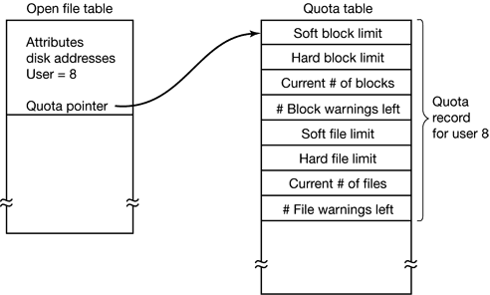
Disk Space Management…

Slide 37
Disk Space Management…
File System Reliability
Destruction of a file system is often a far greater disaster than destruction of a computer.
Recovery mechanisms
Backups
Recover from disaster.
Recover from stupidity.
File System Consistency

Slide 38
Disk Space Management…
File System Performance
Caching
write-through caches- write immediately to disk
Block Read Ahead
improving perceived file system performance is to try to get blocks into the cache before they are needed to increase the hit rate
Reducing Disk Arm Motion
to reduce the amount of disk arm motion by putting blocks that are likely to be accessed in sequence close to each other, preferably in the same cylinder.

Slide 39
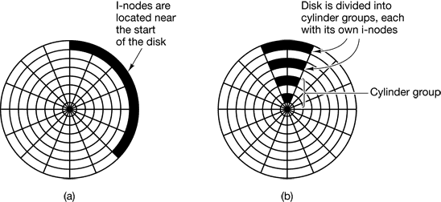
Structure of a Hard disk

